Slide 1

Chapter 8 Recursion

Slide 2
Objectives
To know what is a recursive function and the benefits of using recursive functions (§8.1).
To determine the base cases in a recursive function (§§8.2-8.6).
To understand how recursive function calls are handled in a call stack (§§8.2-8.6).
To solve problems using recursion (§§8.2-8.6).
To use an overloaded helper function to derive a recursive function (§8.5).
To understand the relationship and difference between recursion and iteration (§8.7).

Slide 3

Computing Factorial
factorial(0) = 1;
factorial(n) = n*factorial(n-1);
ComputeFactorial

Slide 4
Computing Factorial
animation
factorial(0) = 1;
factorial(n) = n*factorial(n-1);
factorial(3)

Slide 5
Computing Factorial
animation
factorial(0) = 1;
factorial(n) = n*factorial(n-1);
factorial(3) = 3 * factorial(2)

Slide 6
Computing Factorial
animation
factorial(0) = 1;
factorial(n) = n*factorial(n-1);
factorial(3) = 3 * factorial(2)
= 3 * (2 * factorial(1))

Slide 7
Computing Factorial
animation
factorial(0) = 1;
factorial(n) = n*factorial(n-1);
factorial(3) = 3 * factorial(2)
= 3 * (2 * factorial(1))
= 3 * ( 2 * (1 * factorial(0)))

Slide 8
Computing Factorial
animation
factorial(0) = 1;
factorial(n) = n*factorial(n-1);
factorial(3) = 3 * factorial(2)
= 3 * (2 * factorial(1))
= 3 * ( 2 * (1 * factorial(0)))
= 3 * ( 2 * ( 1 * 1)))

Slide 9
Computing Factorial
animation
factorial(0) = 1;
factorial(n) = n*factorial(n-1);
factorial(3) = 3 * factorial(2)
= 3 * (2 * factorial(1))
= 3 * ( 2 * (1 * factorial(0)))
= 3 * ( 2 * ( 1 * 1)))
= 3 * ( 2 * 1)

Slide 10
Computing Factorial
animation
factorial(0) = 1;
factorial(n) = n*factorial(n-1);
factorial(3) = 3 * factorial(2)
= 3 * (2 * factorial(1))
= 3 * ( 2 * (1 * factorial(0)))
= 3 * ( 2 * ( 1 * 1)))
= 3 * ( 2 * 1)
= 3 * 2

Slide 11
Computing Factorial
animation
factorial(0) = 1;
factorial(n) = n*factorial(n-1);
factorial(3) = 3 * factorial(2)
= 3 * (2 * factorial(1))
= 3 * ( 2 * (1 * factorial(0)))
= 3 * ( 2 * ( 1 * 1)))
= 3 * ( 2 * 1)
= 3 * 2
= 6

Slide 12

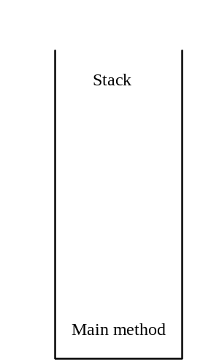
Trace Recursive factorial
animation
Executes factorial(4)

Slide 13

Trace Recursive factorial
animation
Executes factorial(3)

Slide 14
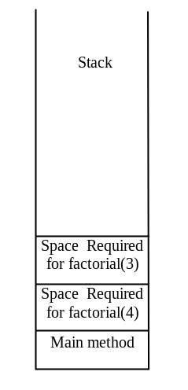
Trace Recursive factorial
animation
Executes factorial(2)

Slide 15
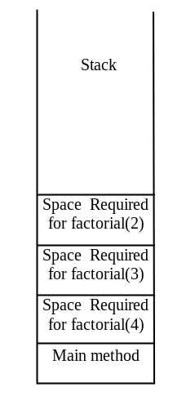
Trace Recursive factorial
animation
Executes factorial(1)

Slide 16
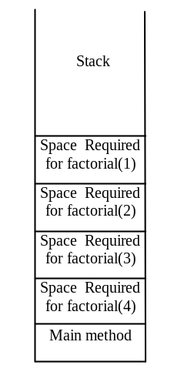
Trace Recursive factorial
animation
Executes factorial(0)

Slide 17
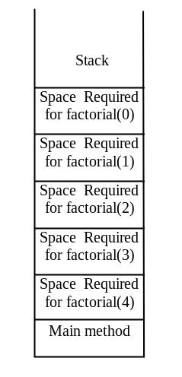
Trace Recursive factorial
animation
returns 1

Slide 18
Trace Recursive factorial
animation
returns factorial(0)

Slide 19
Trace Recursive factorial
animation
returns factorial(1)

Slide 20
Trace Recursive factorial
animation
returns factorial(2)

Slide 21
Trace Recursive factorial
animation
returns factorial(3)

Slide 22
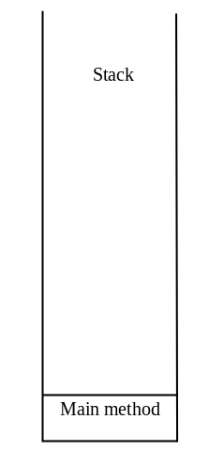
Trace Recursive factorial
animation
returns factorial(4)

Slide 23

factorial(4) Stack Trace

Slide 24
Other Examples
f(0) = 0;
f(n) = n + f(n-1);

Slide 25
Fibonacci Numbers
Finonacci series: 0 1 1 2 3 5 8 13 21 34 55 89…
indices: 0 1 2 3 4 5 6 7 8 9 10 11
fib(0) = 0;
fib(1) = 1;
fib(index) = fib(index -1) + fib(index -2); index >=2
fib(3) = fib(2) + fib(1) = (fib(1) + fib(0)) + fib(1) = (1 + 0) +fib(1) = 1 + fib(1) = 1 + 1 = 2
ComputeFibonacci

Slide 26

Fibonnaci Numbers, cont.

Slide 27
Characteristics of Recursion
All recursive methods have the following characteristics:
  One or more base cases (the simplest case) are used to stop recursion.
  Every recursive call reduces the original problem, bringing it increasingly closer to a base case until it becomes that case.
In general, to solve a problem using recursion, you break it into subproblems. If a subproblem resembles the original problem, you can apply the same approach to solve the subproblem recursively. This subproblem is almost the same as the original problem in nature with a smaller size.

Slide 28
Problem Solving Using Recursion
Let us consider a simple problem of printing a message for n times. You can break the problem into two subproblems: one is to print the message one time and the other is to print the message for n-1 times. The second problem is the same as the original problem with a smaller size. The base case for the problem is n==0. You can solve this problem using recursion as follows:
void nPrintln(char * message, int times)
{
if (times >= 1) {
cout << message << endl;
nPrintln(message, times - 1);
} // The base case is n == 0
}

Slide 29
Think Recursively
Many of the problems presented in the early chapters can be solved using recursion if you think recursively. For example, the palindrome problem in Listing 7.16 can be solved recursively as follows:
bool isPalindrome(const char * const s)
{
if (strlen(s) <= 1) // Base case
return true;
else if (s[0] != s[strlen(s) - 1]) // Base case
return false;
else
return isPalindrome(substring(s, 1, strlen(s) - 2));
}

Slide 30
Recursive Helper Methods
The preceding recursive isPalindrome method is not efficient, because it creates a new string for every recursive call. To avoid creating new strings, use a helper method:
bool isPalindrome(const char * const s, int low, int high)
{
if (high <= low) // Base case
return true;
else if (s[low] != s[high]) // Base case
return false;
else
return isPalindrome(s, low + 1, high - 1);
}
bool isPalindrome(const char * const s)
{
return isPalindrome(s, 0, strlen(s) - 1);
}

Slide 31
Recursive Selection Sort
Find the largest number in the list and swaps it with the last number.
Ignore the last number and sort the remaining smaller list recursively.
RecursiveSelectionSort

Slide 32
Recursive Binary Search
Case 1: If the key is less than the middle element, recursively search the key in the first half of the array.
Case 2: If the key is equal to the middle element, the search ends with a match.
Case 3: If the key is greater than the middle element, recursively search the key in the second half of the array.
RecursiveBinarySort

Slide 33
Recursive Implementation
Optional
int binarySearch(const int list[], int key, int low, int high)
{
if (low > high) // The list has been exhausted without a match
return -low - 1; // Return -insertion point - 1
int mid = (low + high) / 2;
if (key < list[mid])
return binarySearch(list, key, low, mid - 1);
else if (key == list[mid])
return mid;
else
return binarySearch(list, key, mid + 1, high);
}
int binarySearch(const int list[], int key, int size)
{
int low = 0;
int high = size - 1;
return binarySearch(list, key, low, high);
}

Slide 34
Towers of Hanoi
There are n disks labeled 1, 2, 3, . . ., n, and three towers labeled A, B, and C.
No disk can be on top of a smaller disk at any time.
All the disks are initially placed on tower A.
Only one disk can be moved at a time, and it must be the top disk on the tower.

Slide 35
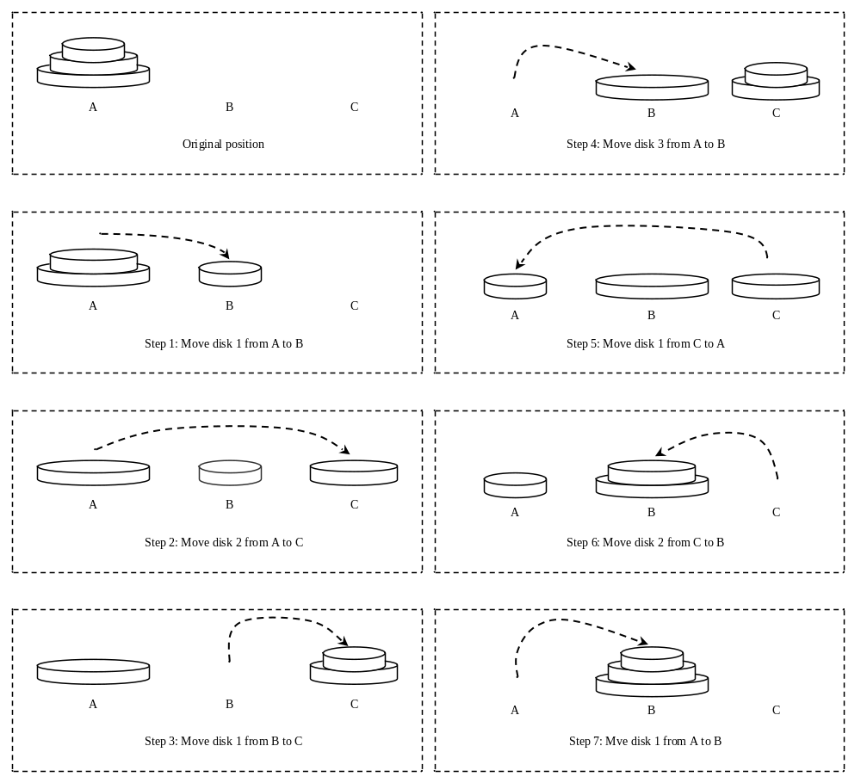
Towers of Hanoi, cont.

Slide 36
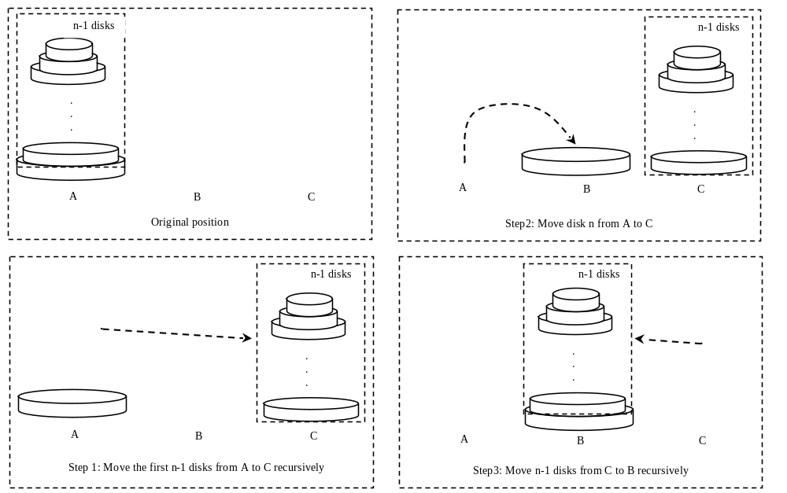
Solution to Towers of Hanoi
The Towers of Hanoi problem can be decomposed into three subproblems.

Slide 37
Solution to Towers of Hanoi
Move the first n - 1 disks from A to C with the assistance of tower B.
Move disk n from A to B.
Move n - 1 disks from C to B with the assistance of tower A.
TowersOfHanoi

